Slide 1
MID TERM PROJECT
Implement and optimize a fixed-size algorithm
with ESL platform
SHIVANI SINGH
309591030

Slide 2
OUTLINE
Emboss filter
Algorithms of Emboss filter
Emboss filter in HLS
Emboss filter in SCML Platform
Results
Demo

Slide 3
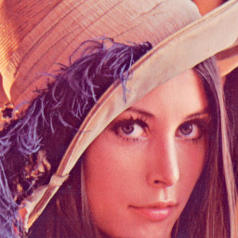
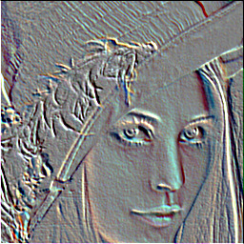
Emboss filter
gives a 3D shadow effect to the image
here's an emboss filter with an angle of 45°
-1 | -1 | 0
-1 | 0 | 1
0 | 1 | 1
X

Slide 4

Algorithms of Emboss Filter
The optimized Emboss filter accelerator has used
Data unrolling with latency constraint
Pipelining
Data Reuse
Notes:
Testbench sends transactions using SCML initiator socket instead of TLM initiator socket.

Slide 5
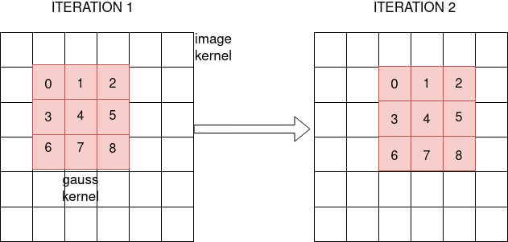
Algorithms of Emboss Filter
DATA REUSE
Emboss kernel
Notes:
Testbench sends transactions using SCML initiator socket instead of TLM initiator socket.

Slide 6
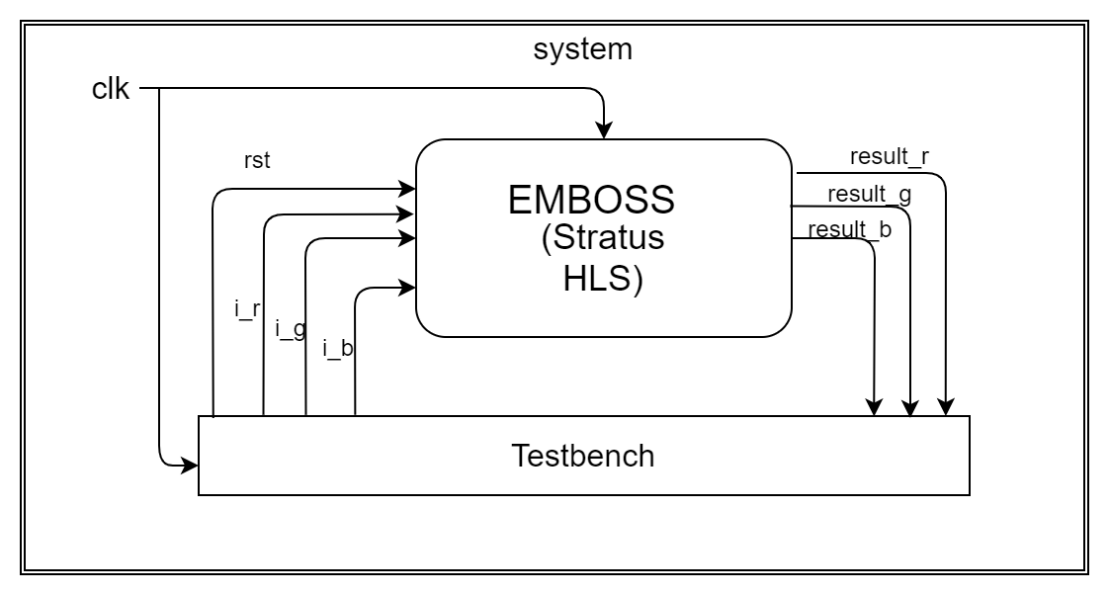
Algorithms of Emboss Filter
NON SPLIT INPUT DATA
Notes:
Testbench sends transactions using SCML initiator socket instead of TLM initiator socket.

Slide 7
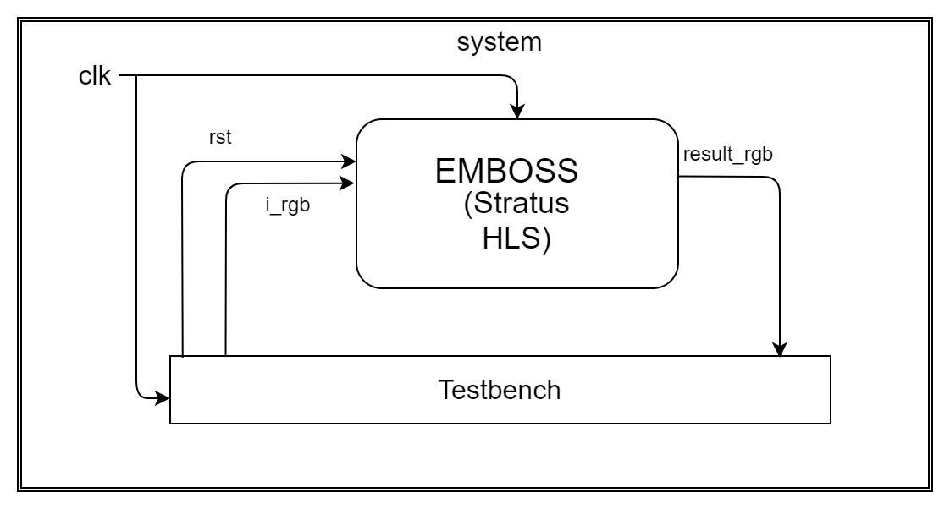
Algorithms of Emboss Filter
SPLIT INPUT DATA
Notes:
Testbench sends transactions using SCML initiator socket instead of TLM initiator socket.

Slide 8
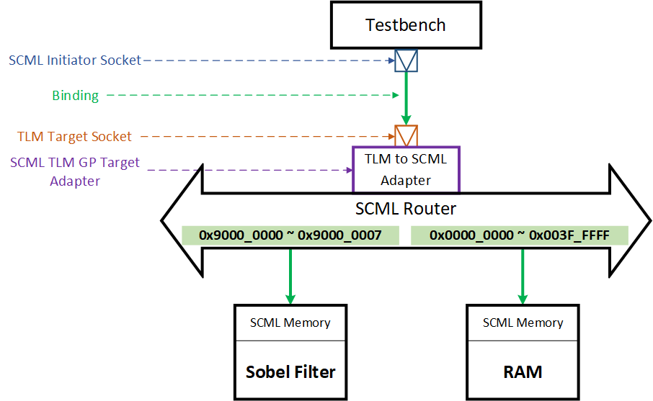
Emboss Filter in SCML Platform

Slide 9
Results
Simulated cycles(ns)
Experiments | B | BASIC | DPA
Base model | 26214450 | 63569910 | 63569756
unroll | 26214450 | 58278900 | 58278798
pipeline | 24276549 | 49867520 | 49866412
Data reuse | 23451210 | 48568310 | 48569310

Slide 10
Results
AREA
Experiments | B | BASIC | DPA
Base model(Splited) | n/a | 3332 | 2939
unroll | n/a | 3224 | 2756
pipeline | n/a | 4322 | 4376
Data Reuse | n/a | 3545 | 3276

Slide 11
CONCLUSION
Thus the area and the simulated cycles are less than that to non reuse data.
Also, the simulated cycles of DPA is more than BASIC but the area of DPA is less than BASIC.

Slide 12
Thank you

